Slide 1

ML Project- Unsupervised and Supervised Learning Topic: Predicting Insurance Fund Performance Using Machine Learning Course: Advanced Topics in Machine Learning Lecturer: Dr. Chen Hajaj Team Members: Itamar Melnik & Tomer Sabag

Slide 2

The Problem
Importance: Evaluating the performance of insurance funds is critical in the financial sector, yet challenging due to the large volume of financial data.
Problem definition: Investors struggle to identify high-performing funds among numerous options, which can lead to inefficient allocation of resources.
Objective: Use machine learning techniques to predict the success of insurance funds and uncover patterns in fund behavior.

Slide 3

Project Goals
Main goal: Predict and analyze the performance of insurance funds to empower stakeholders with actionable insights.
Sub-Goals:
Classification: Predict fund success using supervised learning Models, achieved by evaluating the Alpha measure as a key performance metric.
Clustering: Use unsupervised learning to identify hidden patterns and groupings among insurance funds.
Unified Approach: Both methods complement each other to achieve the main goal by combining predictive accuracy with deeper data-driven insights.

Slide 4
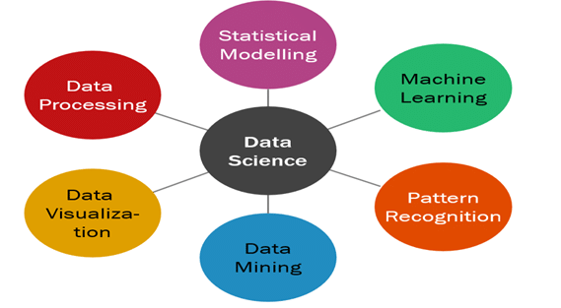
Methods
Data Processing: Handled missing values using imputation techniques tailored to data distribution.
Feature Selection: Identified and selected the most relevant features to enhance model performance.
Hyperparameter Tuning: Optimized model parameters to improve accuracy and reliability.
Classification and Clustering: Used classification models to predict Fund’s success and clustering methods to identify patterns within the data groups.
Evaluation Metrics: Evaluated models using metrics like Accuracy, Precision, Recall, F1-Score for classification, and Silhouette Score and Elbow Method for clustering.
Visualization: Visualized results using bar plots to compare model evaluation metrics, scatter plots for clustering results, and heatmaps (PPS and Spearman matrices) to illustrate feature relationships and correlations.

Slide 5
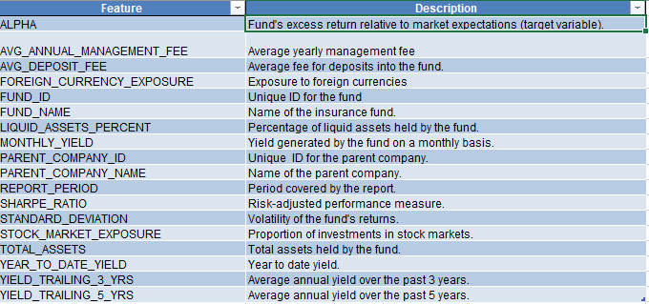
Dataset Overview
Dataset Description: The dataset, sourced from a governmental database, contains detailed financial and performance metrics for insurance funds in 2024. It includes features related to yield, management fees, market exposure, risk level and liquidity.

Slide 6
Clustering Algorithms:
K-Means: Chosen for its simplicity and efficiency in identifying distinct fund groupings based on financial metrics.
Agglomerative Clustering: Used to provide a hierarchical perspective and uncover nested relationships between funds.
DBSCAN: Applied to detect outliers and explore clusters of varying shapes and densities without predefining the number of clusters.

Slide 7
Classification Models:
Random Forest: Selected for its ensemble approach, which combines multiple decision trees to improve accuracy and robustness against overfitting.
Gradient Boosting: Used for its iterative refinement process, delivering high accuracy in complex datasets.
XGBoost: Chosen for its speed and ability to handle large datasets efficiently while reducing overfitting.
SVM: Effective in capturing non-linear relationships and distinguishing overlapping classes.
k-Nearest Neighbors (kNN): Included for its simplicity and to evaluate how well more advanced models perform compared to a straightforward approach.

Slide 8
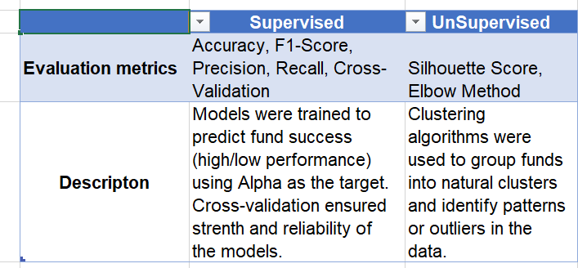
Experiments Overview

Slide 9
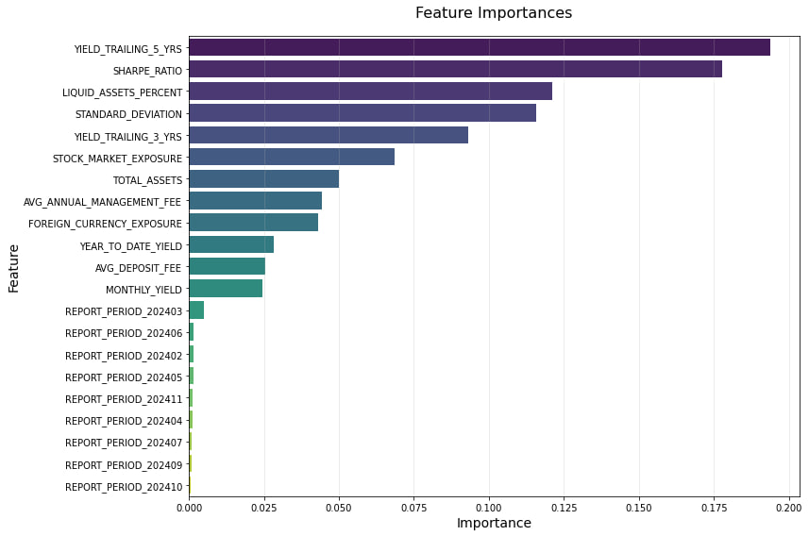
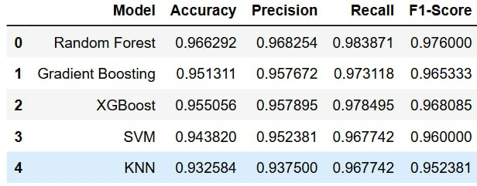
Classification Results

Slide 10
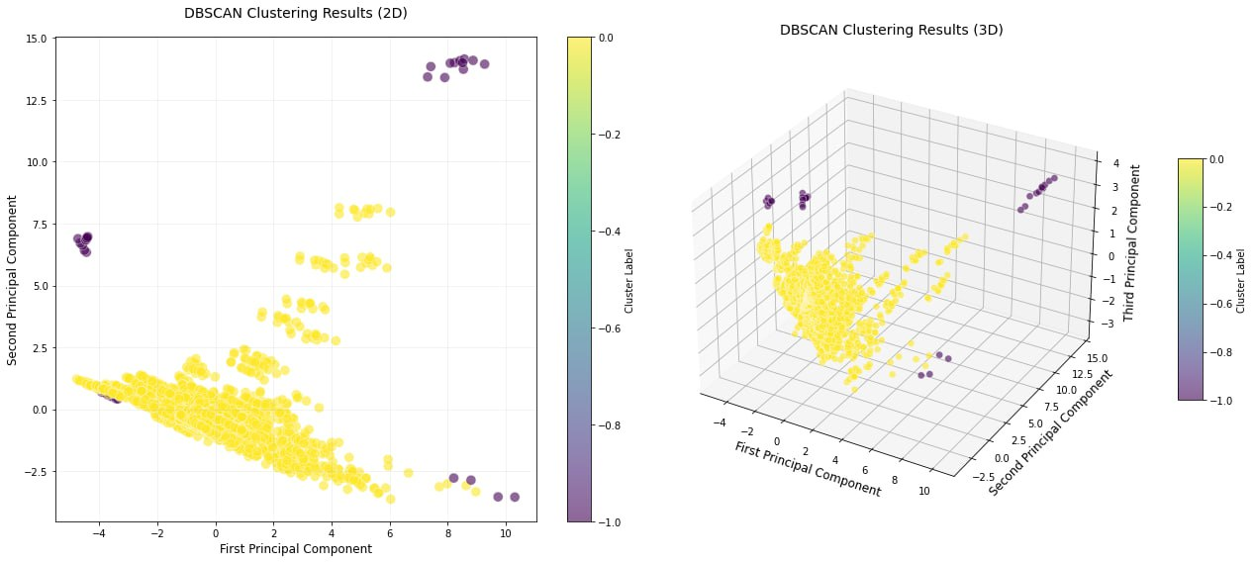
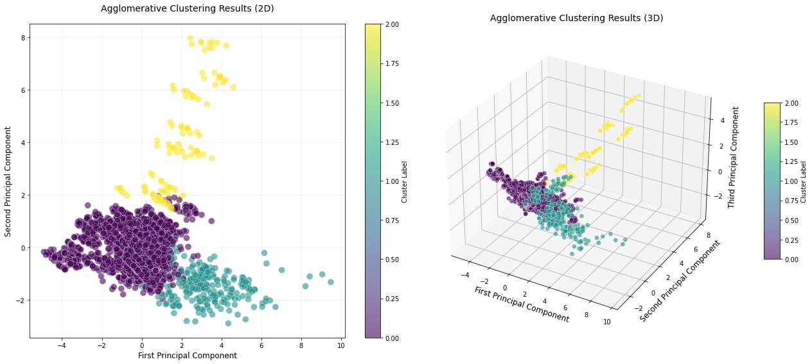
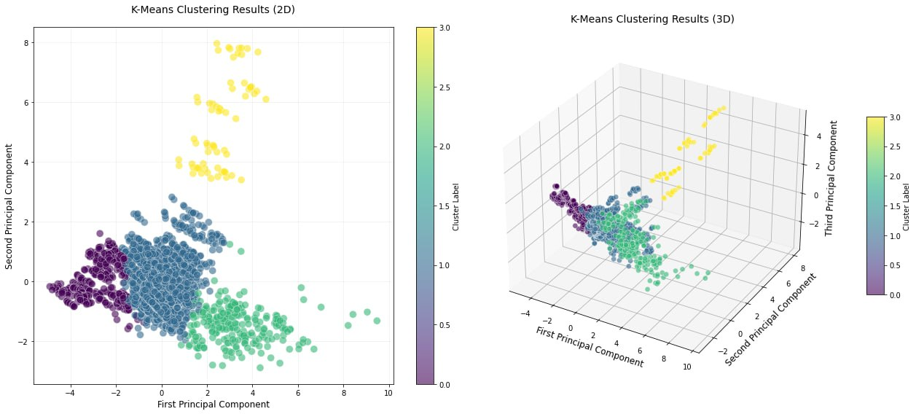
Clustering Results

Slide 11
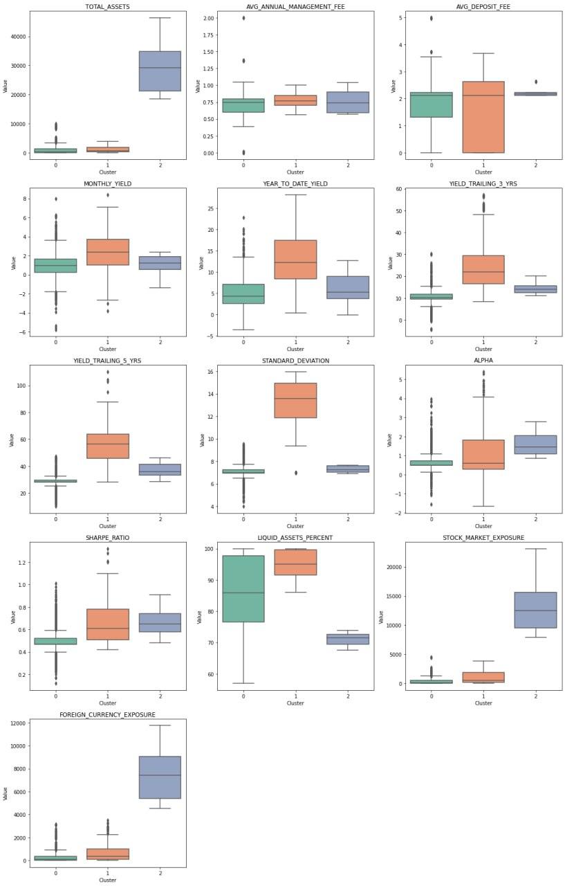
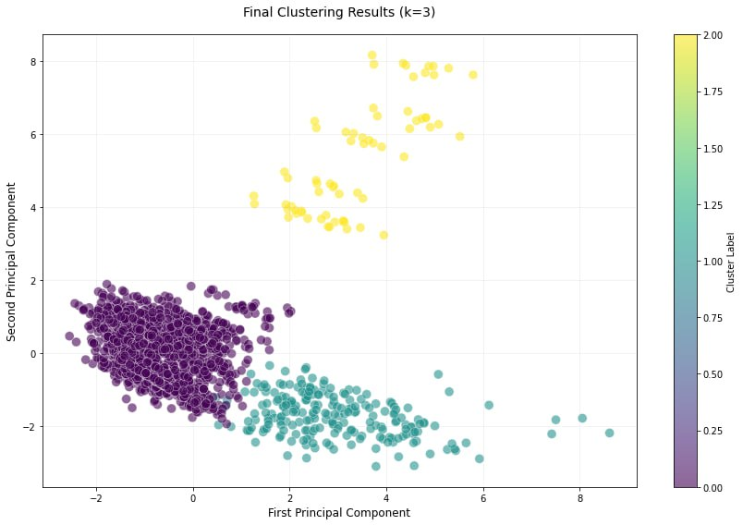
Clustering Results

Slide 12
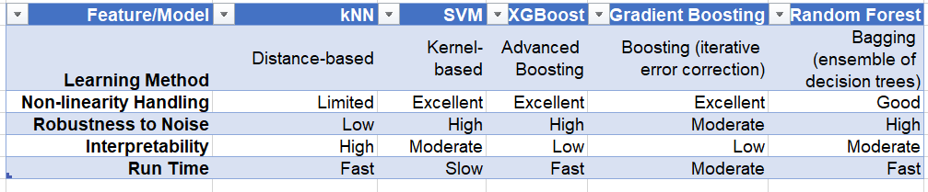
Classification Models Comparison

Slide 13
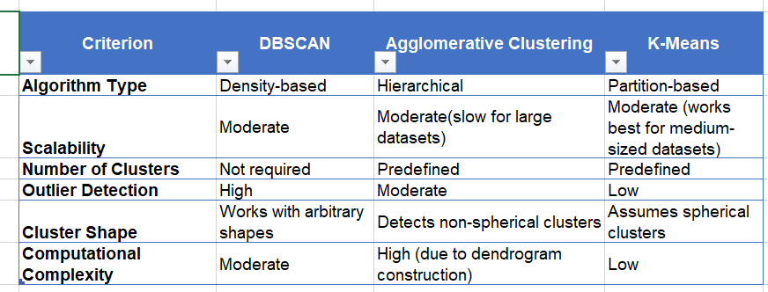
Clustering Algorithms Comparison

Slide 14
Classification Conclusions:
By analyzing fund performance using Random Forest, we successfully predicted fund success based on the Alpha measure, which we transformed into a binar target. The most important predictors were long-term yields (YIELD_TRAILING_5_YRS), risk-adjusted returns (SHARPE_RATIO), and liquidity (LIQUID_ASSETS_PERCENT), emphasizing their role in effective fund evaluation.

Slide 15
Clustering Conclusion:
Cluster 0: Conservative and underperforming funds with low yields and minimal market exposure.
Cluster 1: High-risk, high-yield funds characterized by high standard deviation, strong long-term yields, and high liquidity.
Cluster 2: Well-diversified funds with significant TOTAL_ASSETS and STOCK_MARKET_EXPOSURE, though not always achieving the highest yields
Key Insight: We learned that high risk, as indicated by high standard deviation, and high liquidity lead to better performance compared to large asset holdings and high exposure to stocks and foreign currencies.

Slide 16

Unified Conclusion:
To achieve optimal long-term performance, stakeholders should prioritize funds with strong long-term returns, high liquidity, and a well-managed risk profile. While higher risk (indicated by variability in returns) often correlates with better performance.

